Slide 1
Learning Session 1 Overview of ‘A’(analyze) from the D-M-A-I-C Model

Slide 2
The presence of the Laboratory African Regional Collaboration (LARC) logo on slides
indicates that content (in whole or in part) originates with the LARC Program

Slide 3
Analyze
Root Cause Analysis
Fishbone / Cause & Effect / Ishikawa Diagram
5 Whys
Pareto Diagram
LARC Workbook, p. 56-62
https://www.larccqi.org/uploads/resources/LARC-3.0-WORKBOOK.pdf
LARC Workbook

Slide 4
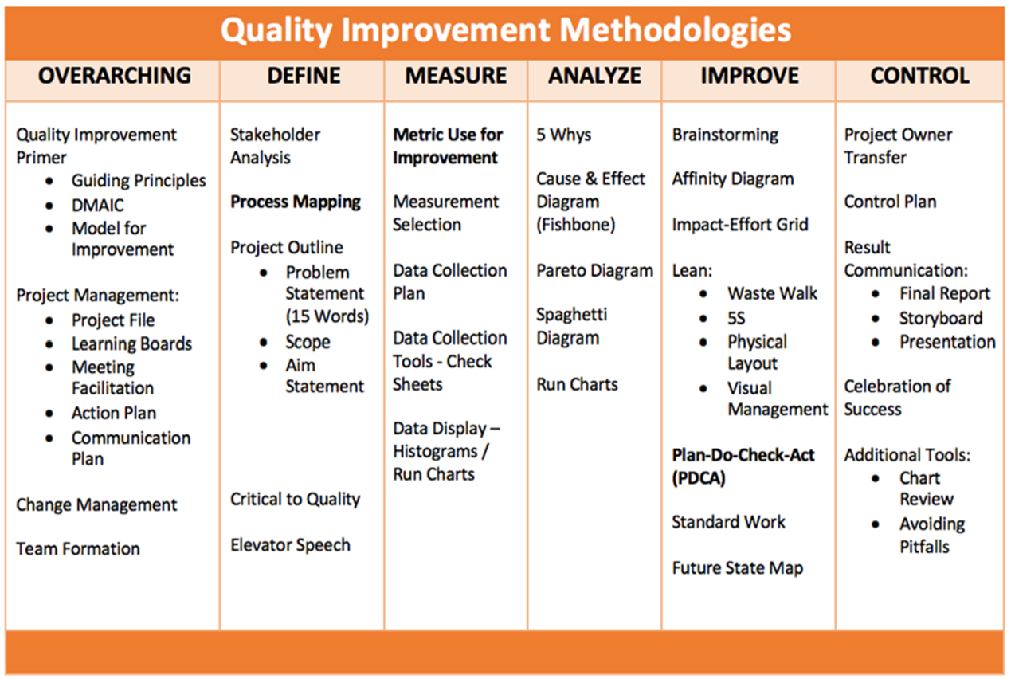
LARC Workbook

Slide 5
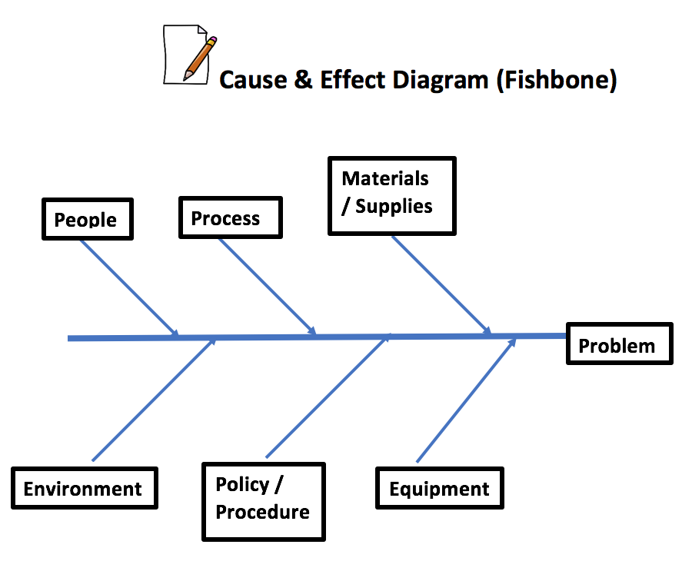
Fishbone Diagram
Categories to Review for Potential Causes
6 Ms
Man (People)
Methods (Policy/Procedure)
Materials (Supplies)
Mother Nature (Environment)
Measurement (Process)
Machine (Equipment)
LARC Workbook, p. 59
https://www.larccqi.org/uploads/resources/LARC-3.0-WORKBOOK.pdf
LARC Workbook

Slide 6
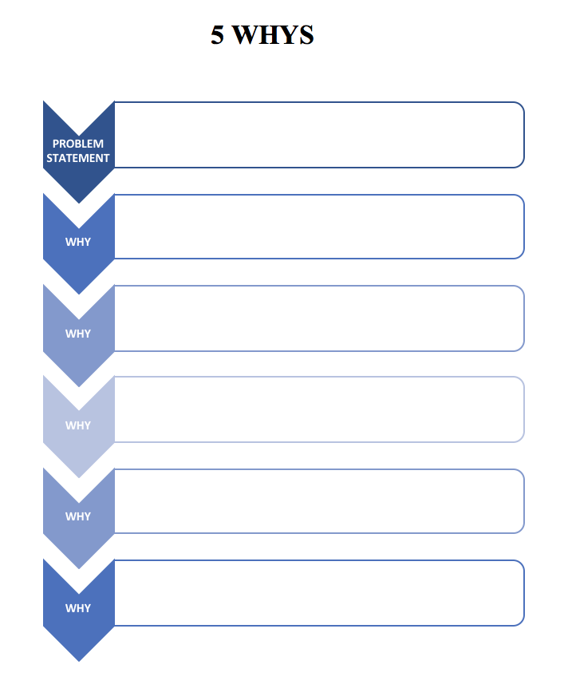
5 Whys
LARC Workbook, p. 57
https://www.larccqi.org/uploads/resources/LARC-3.0-WORKBOOK.pdf
LARC Workbook

Slide 7
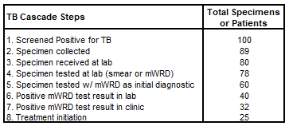
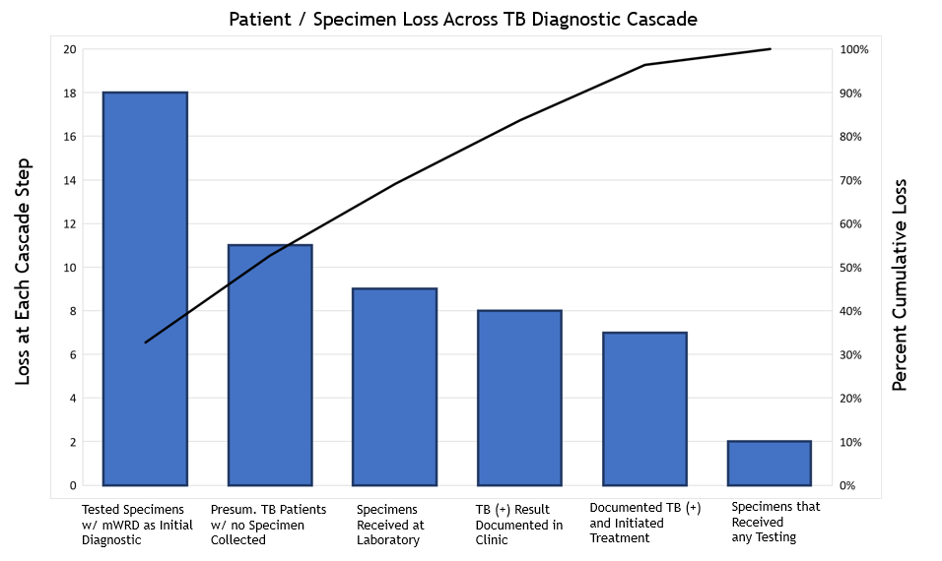
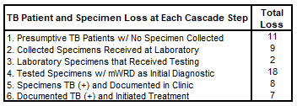
Pareto Chart
LARC Workbook

Slide 8
Learning Session 1 Deliverables
DEFINE/ MEASURE/ ANALYZE
Identify Stakeholders
Team Formation
Map the Process (Current)
ID/ Prioritize Opportunities
Project Outline
Baseline Metrics - Data Collection Tool/Plan
Action Plan
Elevator Speech
VOC Information
Root Cause Analysis
1 Rapid/Small Test of Change (PDSA)
Presentation
LARC Workbook

Slide 9
See You at Learning Session 2!

Slide 10
Questions?

